Slide 1

End-to-End Adversarial Memory Network for Cross-domain Sentiment Classification
Zheng Li, Yu Zhang, Ying Wei, Yuxiang Wu, Qiang Yang
Hong Kong University of Science and Technology
Notes:
Good afternoon, everyone. My name is LI Zheng, from Hong Kong University of Science and Technology. Today, I will introduce my research work, End-to-End Adversarial Memory Network for Cross-domain Sentiment Classification.

Slide 2
Overview
Problem & Related Work
Motivation
End-to-End Adversarial Memory Network
Experiment
Future work
Notes:
I will split up my presentation into 5 parts. Firstly, let me introduce the problem and related works

Slide 3


Sentiment classification
One of the best Crichton novels Sphere by Michael Crichton. It is an excellent novel.
I was disappointed in this book--especially after reading the other stellar reviews.
Current Solution
-Supervised Machine Learning
E.g., Deep Neural Networks
Notes:
Sentiment classification is an important task in NLP. This task aims to identify the overall sentiment polarity (e.g., positive or negative) of a document.
Here is a very simple example about sentiment classification. Usually, we can identity the sentiment according to the key words like excellent and disappointed. Currently, supervised machine learning method especially deep neural networks can achieve state-of-the-art performance over a lot of benchmark datasets.

Slide 4


Cross-Domain Sentiment classification
Testing data
Training data
Books
Books
84%
Sentiment Classifier
Restaurant
Challenges of Domain Adaptation:
-Domain discrepancy
76%
Notes:
Unfortunately, effective deep learning methods are highly dependent on large amounts of labeled training. Sometimes we do not have enough or even no labeled data in the target domain. Therefore, cross-domain sentiment classification, which utilizes labeled data from related domains, becomes a promising direction.
The main challenge of cross-domain sentiment classification is the domain discrepancy[dɪs'krep(ə)nsɪ], which may reduce performances of thetask. Fox example, if the source domain and the target domain are both the book domain, the accuracy can achieve 86%, but the if the target domain is restaurant domain, the accuracy can drop to 74%.

Slide 5
Cross-Domain Sentiment classification
sent | Books (source domain) | Restaurant (target domain) | sent
 | Great books. His characters are engaging. | The food is great, and the drinks are tasty and delicious.
 | It is a very nice and sobering novel. | The food is very nice and tasty, and we’ll go back again.
 | A awful book and it is a little boring. | Shame on this place for the rude staff and awful food.
Useful for target domain
Pivots(domain-shared words): great, nice, awful
Notes:
In detail, This domain discrepancy reflects in sentiment words. As we can see from this table, the marked pink words appear in both domains. . We usually call these domain-shared sentiment words like great, awful as pivots. They are useful for the target domain because they contribute more to the domain-invariant representations

Slide 6
Cross-Domain Sentiment classification
sent | Books (source domain) | Restaurant (target domain) | sent
 | Great books. His characters are engaging. | The food is great, and the drinks are tasty and delicious.
 | It is a very nice and sobering novel. | The food is very nice and tasty, and we’ll go back again.
 | A awful book and it is a little boring. | Shame on this place for the rude staff and awful food.
Non-Pivots(domain-specific words):
source domain: engaging, sobering…
target domain: delicious, tasty…
Notes:
Besides, there are also domain-specific sentiment words, which only occur in their corresponding domain. Like engaging ,boring in the books domain, tasty, delicious, rude in the restaurant domain.

Slide 7
Related Work
Traditional methods
Need to manually select pivots (tedious!).
Structural Correspondence Learning (SCL) [Blitzer et al., 2006]:
Term frequency on both domains.
Structural Correspondence Learning- Mutual Information (SCL-MI) [Blitzer et al., 2007]:
Mutual information between features and labels (source domain).
Spectral Feature Alignment (SFA)[Pan et al., 2010]:
Mutual information between features and domains.
Notes:
Most traditional methods need manually select pivots based on criterions[krai'tiəriən] such as the Term frequency on both domains, Mutual information between features and labels (source domain) and Mutual information between features and domains.

Slide 8
Related Work
Deep learning methods
Learn to discover intermediate representations that are shared across domains.
But lack of the interpretability of identifying pivots (black box!).
Stacked Denoising Autoencoder (SDA) [Glorot et al., 2011]:
Learn by reconstruction.
Marginalized Stacked Denoising Autoencoder (mSDA) [Chen et al.,2012]:
Learn by reconstruction.
Domain-Adversarial Training of Neural Networks (DANN) [Ganin et al., 2016]:
Gradient reversal layer.
Notes:
Recently, deep learning methods are exploited to discover intermediate representations that are shared across domains. Like
Stacked Denoising Autoencoder and Marginalized Stacked Denoising Autoencoder , which lean a unified representation by reconstruction. And Domain-adversarial training of Neural Networks, which use gradient reversal layer to reverse the gradient of neural network in order to make the domain classifier indiscriminate between the representation from the source and target domains. However, they lack of the interpretability [in'tə:prit]of identifying the pivots

Slide 9
Contributions
We propose an end-to-end adversarial memory network (AMN), which can automatically capture the pivots using the attention mechanism without manually selecting pivots.
Unlike previous deep learning methods that cannot tell us which words are the pivots, our model can offer a direct visualization of them, which makes the representations shared by domains more interpretable.
Notes:
Different from the previous methods,

Slide 10
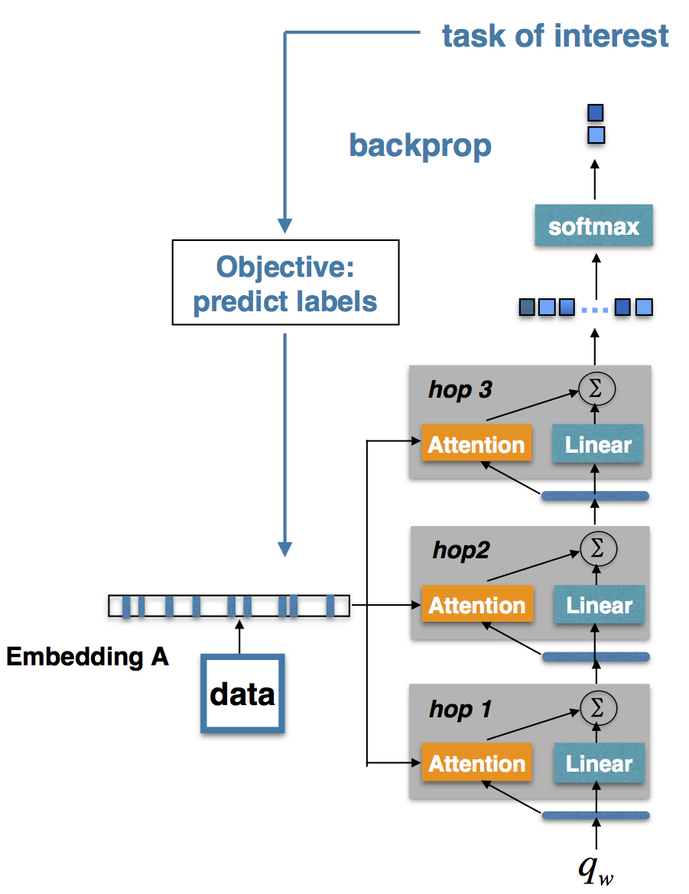
Motivation
Memory network can capture the corresponding important evidences (sentences, words) using the attention mechanism according to the task of interest.
Unlike QA tasks, our query is a randomly initialized vector, which can be learned for a high-level representation.
Figure 1: Memory network.
Notes:
Firstly, let me briefly introduce a variant of the memory network.
As illustrated in Figure 1, a memory network contains multiple hops, each of which consists of an attention layer and a linear layer. In the first hop, we use a query vector qw as the input to capture important words from memory m through the attention layer. The query vector will interact with the document to get context-aware word attentions. The output of the attention layer and the linear transformation of the query vector are combined as the input of the next hop in order to capture more abstract evidences. The output vectors in the last hop are considered as representations of a document with respect to the queries.

Slide 11
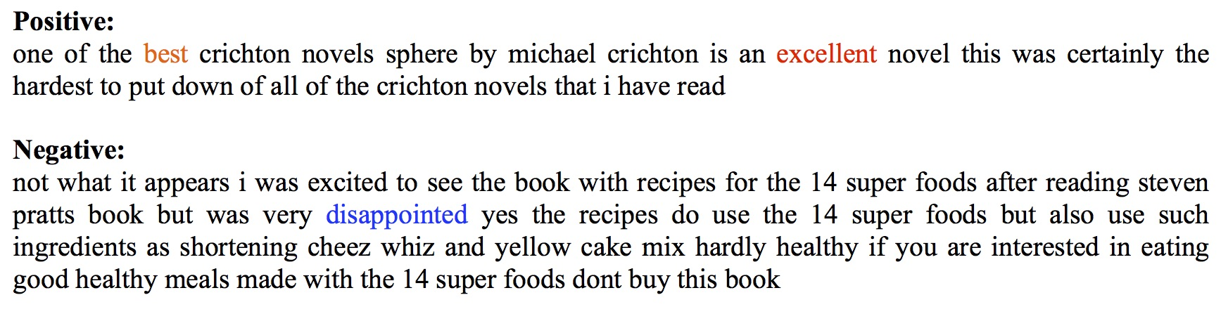
Motivation
Task1: sentiment classification
Query meaning: what is the sentiment word?
Notes:
Fox example,
If the task is sentiment classification, memory network can find important sentiment words to make sentiment classifier predict the polarity of reviews better. The words with red or blue color mean high attention score.
Therefore, the query can stand for a meaning of ‘what is the sentiment word’

Slide 12
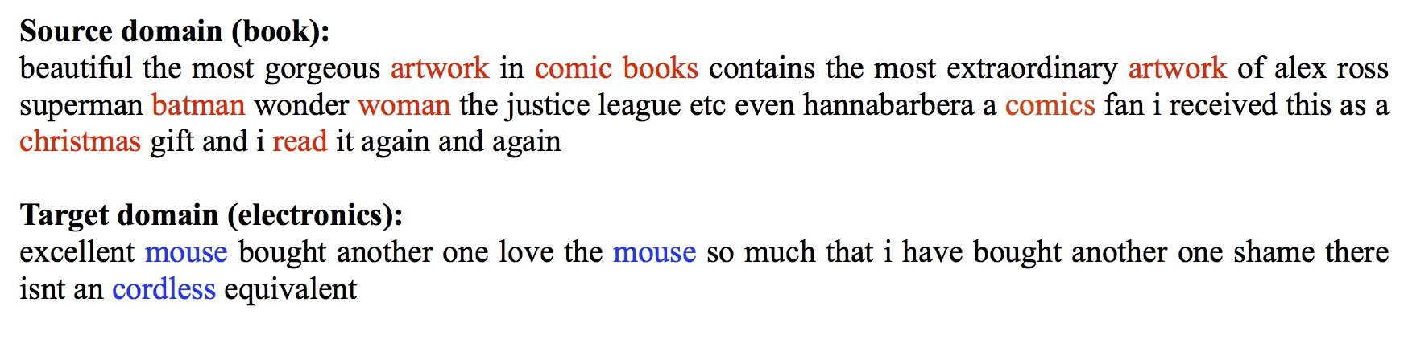
Motivation
Task2: domain classification
Query meaning: what is the domain-specific word?
However, we need to focus on domain-shared words, which can be achieved by adversarial training to realize domain confusion.
Notes:
For another example, If the task is domain classification, memory network can find important domain-specific words to make domain classifier predict the domain of reviews better.
Likes the read words artwork, comic oks for the book domain, or blue words mouse cordless for the electronics domain.
However, we need to make the memory network produce a representation that focuses on domain-shared words in order to confuse the domain classifier.
Here, confuse means to make a domain classifier incapable of discriminating samples from the source or target domains

Slide 13
Motivation
Characteristic of pivots
Feature1: They are the important sentiment words.
Feature2: They are shared in both domains.
In order to automatically extract pivots, we use two parameter-shared memory networks:
MN-sentiment: sentiment classification in the source domain (task1) for Feature1.
MN-domain: domain classification (task2) based on adversarial training for Feature2.
Jointly trained: minimize the sentiment classification errors and make a domain classifier incapable of discriminating samples from the source and target domains.
Then, the query stands for a higher-level representation - what is the pivot?
Notes:
Then, let’s see, our goal is to extract pivots automatically. Pivots have two characteristics. First, they are important sentiment words. Second, They are shared in both domains.
The first memory network named MN-sentiment for .. In order to capture the words with feature1
The second memory network named MN-domain for in order to capture the words with feature 2
These two parameter-shard memory networks , which share all parameters including the query vector
In this way, the query stands for a higher-level representation of ‘what is the pivots’

Slide 14
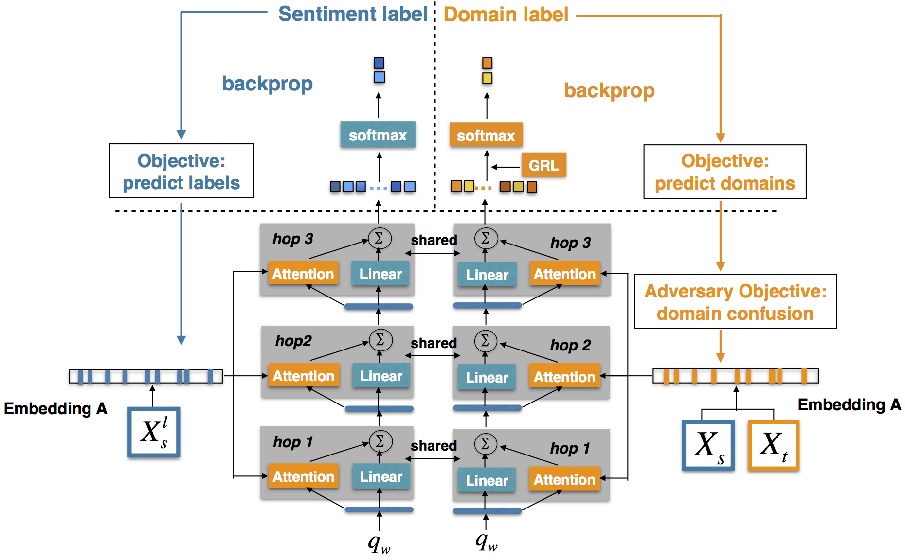
Overview of our model
Sentiment classifier
Domain classifier
MN-sentiment
MN-domain
Figure 2: The framework of the Adversarial Memory Network (AMN) model.
Notes:
Here is an overview of our model, which mainly consists of four parts. The MN-sentiment, MN-domain, sentiment classifier and domain classifier. The labeled data in the source domain will be feed to MN-sentiment for sentiment classification. All data including labeled data and unlabeled data from the source and target domains will be feed to MN-domain for domain classification.

Slide 15
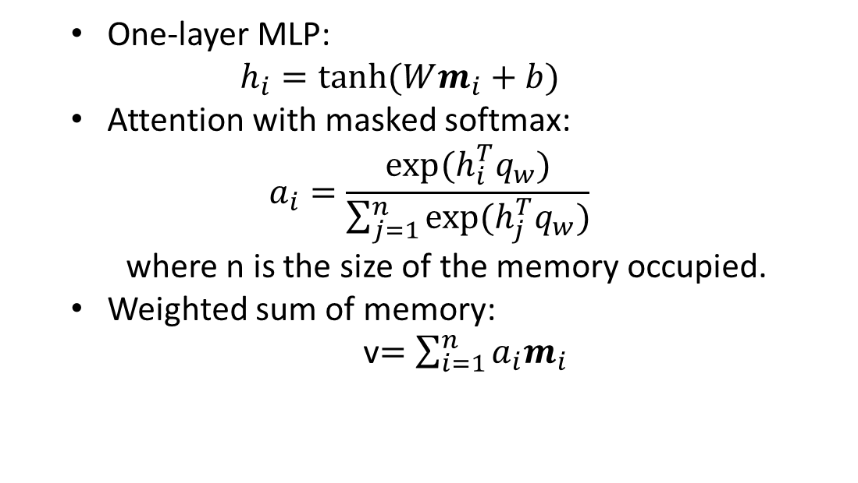
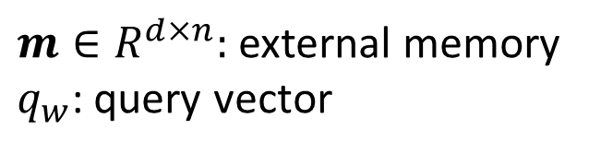
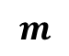
Memory Network
Notations
$m∈R^{d×n}:$ external memory
$q_{w}$: query vector
Attention layer:
v
One-layer MLP: $h_{i}=tanh⁡(Wm_{i}+b)$
Attention with masked softmax:
$$a_{i}=\frac{exp⁡(h_{i}^{T}q_{w})}{\sum_{j=1}^{n}{exp⁡(h_{j}^{T}q_{w})}}$$
where n is the size of the memory occupied.
Weighted sum of memory:
v$=\sum_{i=1}^{n}{a_{i}m_{i}}$
$$m$$
v
v
Figure 3: Memory network.
Notes:
Given a document D = {$w_{1},$ $w_{2}$, … $w_{n}$}, we stacked their word vectors and put into the external memory $m$ and the free memories are padded with zero vectors. For the attention layer, we feed the memory vectors into a one-layer MLP and get the hidden representations. The query vector will interact with the hidden representations to get context-aware attentions by masked softmax. Where n is the size of the memory occupied. Lastly, we get the output of attention layer by weighted sum of the memor.

Slide 16
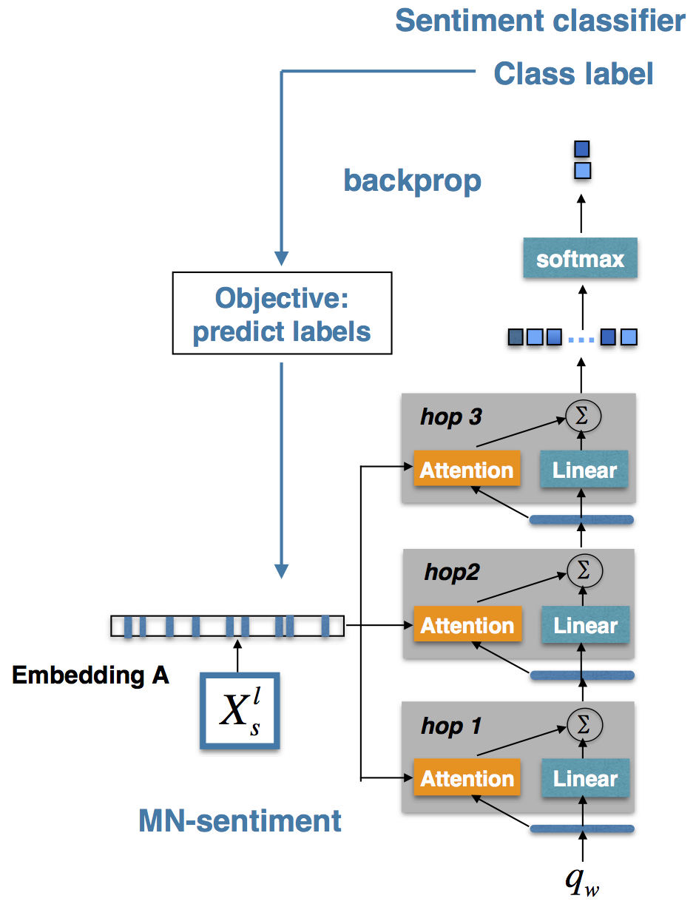
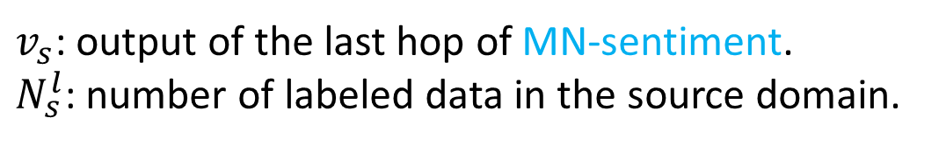
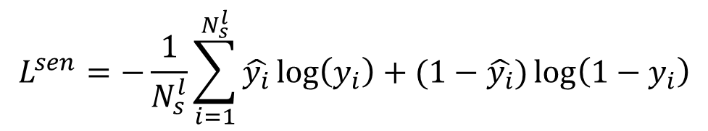
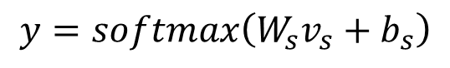
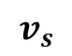
Sentiment Classifier
Notations
$v_{s}$: output of the last hop of MN-sentiment.
$N_{s}^{l}$: number of labeled data in the source domain.
$$v_{s}$$
Sentiment Loss:
$$y=softmax\left(W_{s}v_{s}+b_{s}\right)$$
$$L^{sen}=−\frac{1}{N_{s}^{l}}\sum_{i=1}^{N_{s}^{l}}{\hat{y_{i}}\log\left(y_{i}\right)+(1−\hat{y_{i}})\log\left(1−y_{i}\right)}$$
Figure 4: MN-sentiment.
Notes:
We treat the output vector in the last hop of the MN-sentiment as the document representation $v_{s}$ and feed it to the softmax layer for sentiment classification:
The goal of the sentiment classifier is to minimize the cross-entropy for labeled data in the source domain:

Slide 17
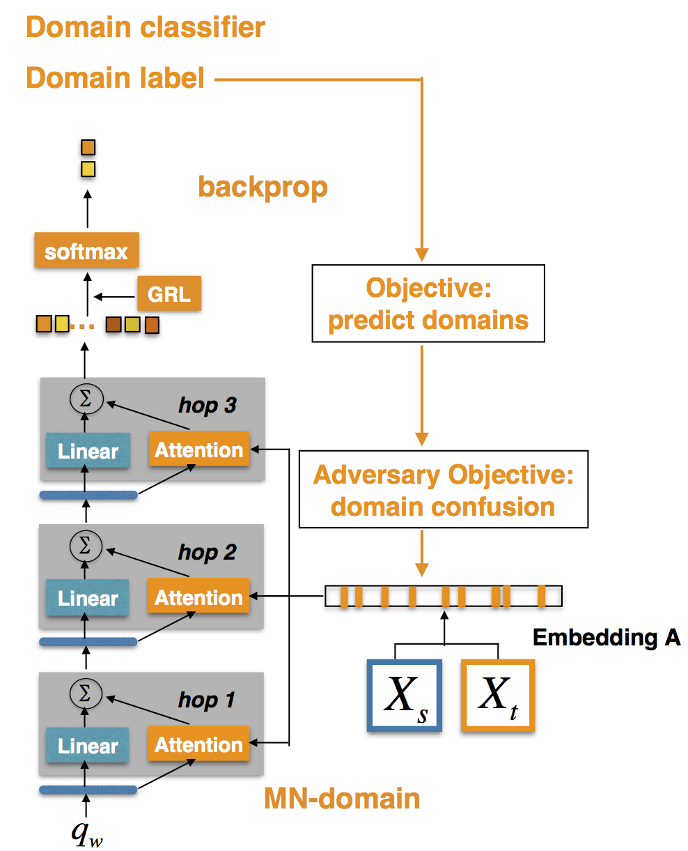
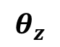
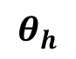
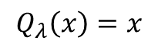
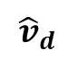

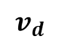
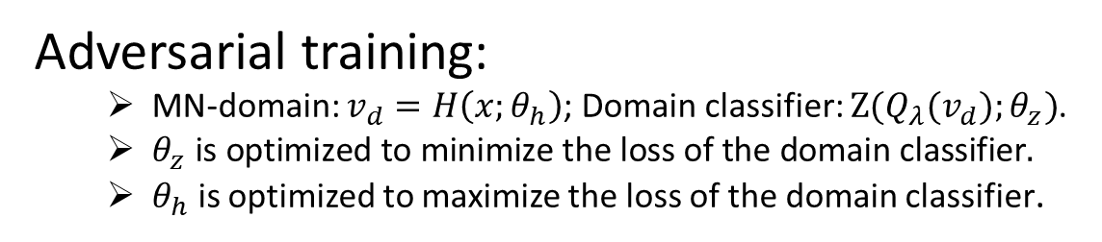
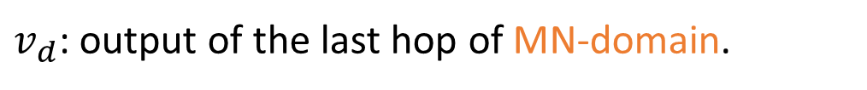
Domain classifier
Notations
$v_{d}$: output of the last hop of MN-domain.
$$θ_{z}$$
Gradient Reversal Layer (GRL) [Ganin et al., 2016]:
$${\hat{v}}_{d}$$
$$v_{d}$$
$$Q_{λ}\left(x\right)=x$$
$$\frac{∂Q_{λ}\left(x\right)}{∂x}=−λI$$
Adversarial training:
MN-domain: $v_{d}=H\left(x;θ_{h}\right)$; Domain classifier: $Z(Q_{λ}(v_{d});θ_{z})$.
$θ_{z} \text{is} \text{optimized} \text{to} \text{minimize} \text{the} \text{loss} \text{of} \text{the} \text{domain} \text{classifier}.$
$θ_{h}$ is optimized to maximize the loss of the domain classifier.
$$θ_{h}$$
Figure 5: MN-domain.
Notes:
We feed the output vector $v_{d}$ in the last hop of the MN-domain network to Gradient Reversal Layer (GRL) [Ganin et al., 2016]:
We can formulate GRL as a ‘pseudo-function’ Q(x) ['psju:dəu] by two equations below in order to describe its forward- and backward- behaviours:
During the forward prop- agation, the GRL acts as an identity function
but during the backpropagation, the GRL will reverse the gradient from the subsequent level by multiplying minus lamada
Leaning with GRL is adversarial pə'ræmitəraized
Notes:
Gradient Reversal Layer (GRL) :
Forward stage: identity function $Q_{λ}\left(x\right)=x$, here $Q_{λ}\left(v_{d}\right)=v_{d}$ = ${\hat{v}}_{d}$
Backward stage (gradient): $\frac{∂Q_{λ}\left(x\right)}{∂x}=−λI$， 梯度反转了$λ$倍
Parameter $θ_{z}$ is optimized to minimize the loss of the domain classifier
假设domain classifier的损失函数为loss1
正常的梯度下降，GRL上面的参数优化loss是通过 x = x – lr * $\frac{∂loss1}{∂x}$ , 最小化loss1
Parameter $θ_{h}$ is optimized to maximize the loss of the domain classifier
梯度反转， GRL下面的参数优化loss是通过 x = x - lr * $\frac{∂loss1}{∂x} ∗（−λ）$ = x - $λ$* lr * $\frac{∂（−loss1）}{∂x}\text{= }\text{x}\text{ − }λ\text{∗ }\text{lr}\text{ ∗ }\frac{∂loss2}{∂x} \text{, }$
因为loss2=-loss1，所以最小化loss2相当于最大化loss1

Slide 18
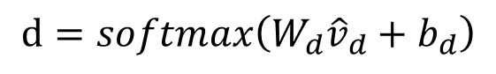
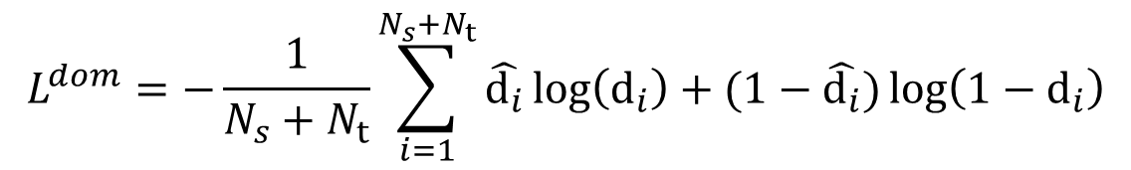
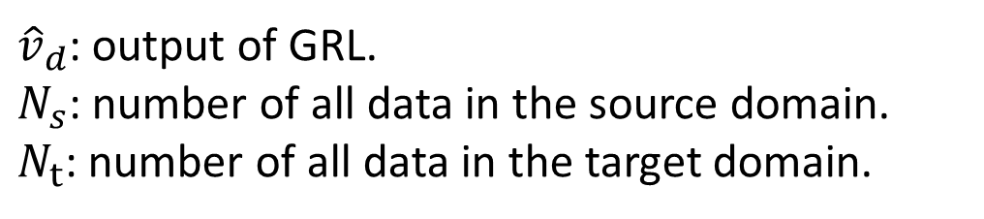
Domain classifier
Notations
${\hat{v}}_{d}$: output of GRL.
$N_{s}$: number of all data in the source domain.
$N_{t}$: number of all data in the target domain.
$${\hat{v}}_{d}$$
$$v_{d}$$
Domain Loss:
$$d=softmax\left(W_{d}{\hat{v}}_{d}+b_{d}\right)$$
$$L^{dom}=−\frac{1}{N_{s}+N_{t}}\sum_{i=1}^{N_{s}+N_{t}}{\hat{d_{i}}\log\left(d_{i}\right)+(1−\hat{d_{i}})\log\left(1−d_{i}\right)}$$
Figure 5: MN-domain
Notes:
We feed the output vector ${\hat{v}}_{d}$of GRL to the softmax layer for domain classification:
The domain classifier is trained to minimize the cross-entropy for all data from the source and target domains except adversarial part:

Slide 19
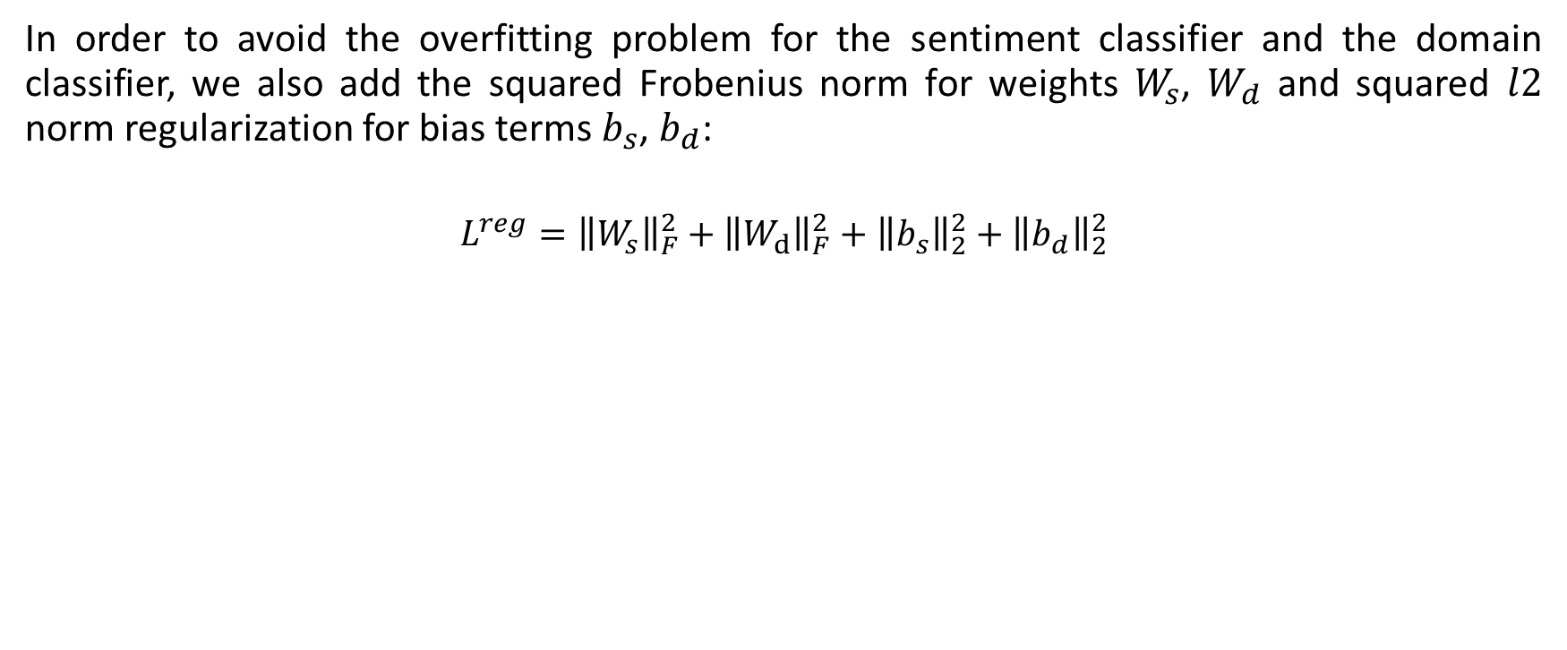
Regularization
In order to avoid the overfitting problem for the sentiment classifier and the domain classifier, we also add the squared Frobenius norm for weights $W_{s}$, $W_{d}$ and squared $l2$ norm regularization for bias terms $b_{s}$, $b_{d}$:
$$L^{reg}={\left\|W_{s}\right\|}_{F}^{2}+{\left\|W_{d}\right\|}_{F}^{2}+{\left\|b_{s}\right\|}_{2}^{2}+{\left\|b_{d}\right\|}_{2}^{2}$$
Notes:
Frobenius

Slide 20
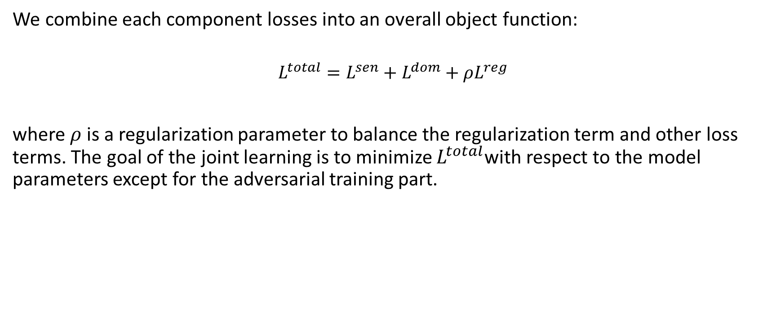
Joint Learning
We combine each component losses into an overall object function:
$$L^{total}=L^{sen}+L^{dom}+ρL^{reg}$$
where $ρ$ is a regularization parameter to balance the regularization term and other loss terms. The goal of the joint learning is to minimize $L^{total}$with respect to the model parameters except for the adversarial training part.

Slide 21
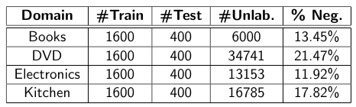
Dataset
Table1: Statistics of the Amazon reviews dataset including the number
of training, testing, and unlabeled reviews for each domain as well as the portion of negative samples in the unlabeled data.

Slide 22
Compared Methods
Traditional methods:
SCL: Structural Correspondence Learning [Blitzer et al., 2006]
SFA: Spectral Feature Alignment [Pan et al., 2010]
Deep learning methods based on adversarial training:
DANN: Domain-Adversarial Training of Neural Networks [Ganin et al., 2016]
DAmSDA: DANN [Ganin et al., 2016] + mSDA [Chen et al.,2012]
DACNN: DANN [Ganin et al., 2016] + CNN [Kim, 2014]

Slide 23
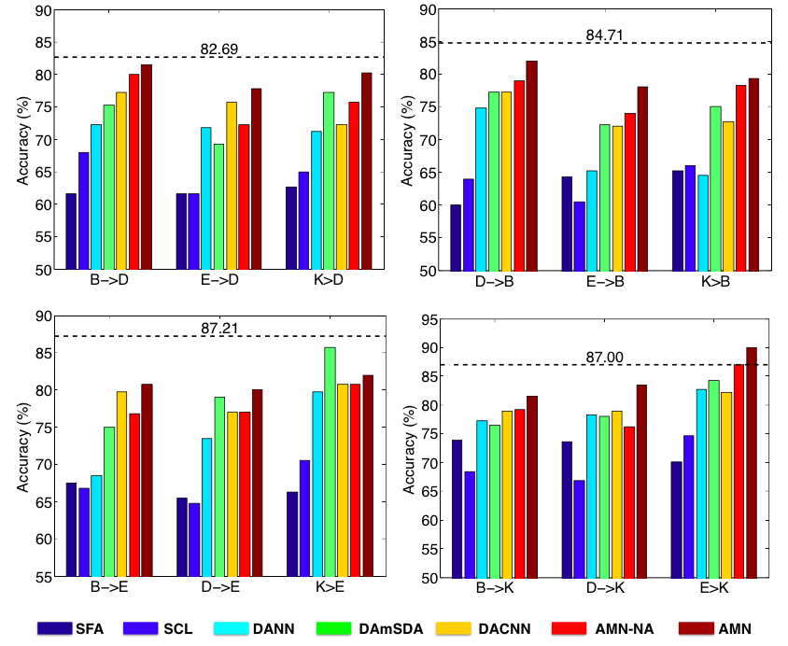
Comparison Results
Our model significantly outperforms the traditional methods.
Our model exceeds the state-of-the-art adversarial training based methods.
Figure 6: Average results for cross-domain sentiment classification on the Amazon reviews dataset.
Notes:
We construct 12 transfer pairs between different domains and compare with different methods including traditional methods which need to manually select pivots and deep learning methods. The different colors mean different method, our method AMN is brown

Slide 24
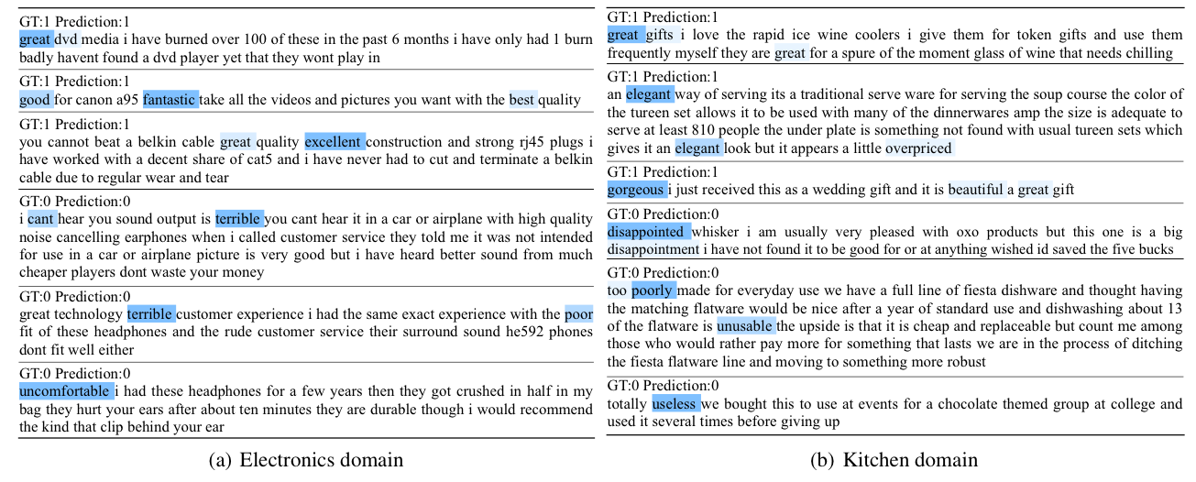
Visualization of Attention
Figure 7: Samples from the Amazon reviews dataset in the E->K task. Deeper color implies larger
attention weights. Label 1 denotes positive sentiment and label 0 denotes negative sentiment.
Notes:
We have visualized the attention for reviews between different domains. Fox example, the source domain is electronics and target domain is kitchen,
We can see our model can attend to the pivots between different doamins.

Slide 25
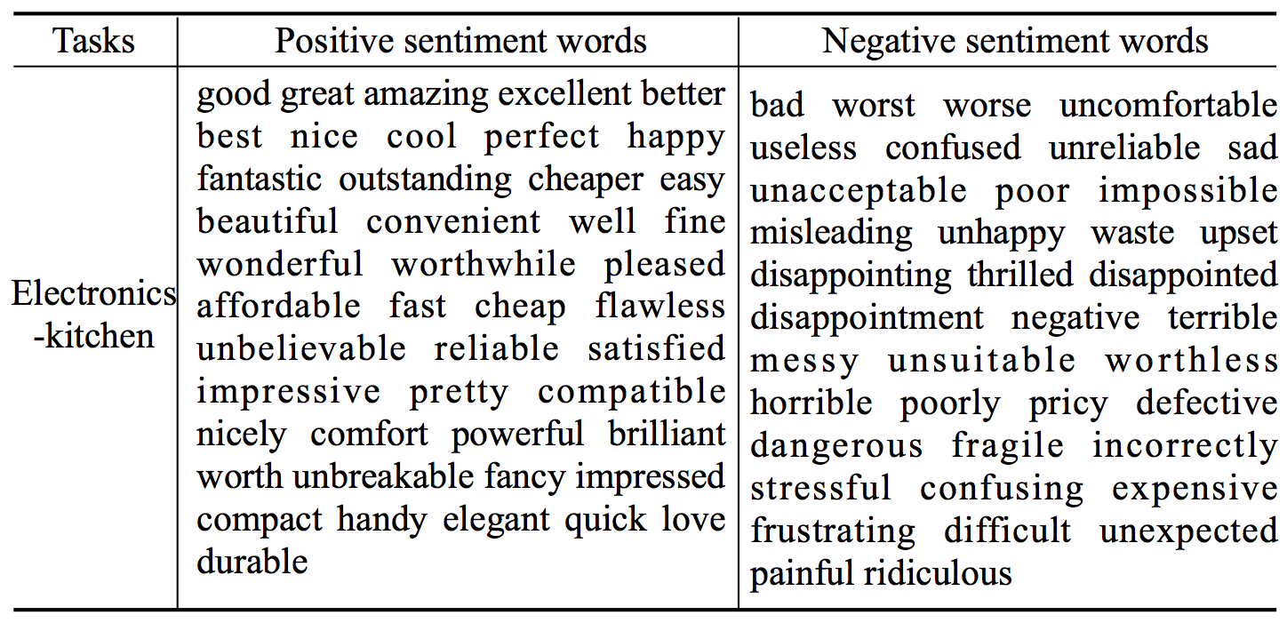
Visualization of Attention
Figure 8: Samples of pivots captured by AMN in the E->K task.
Notes:
There are samples of pivots captured by our model in the E-K tasks

Slide 26
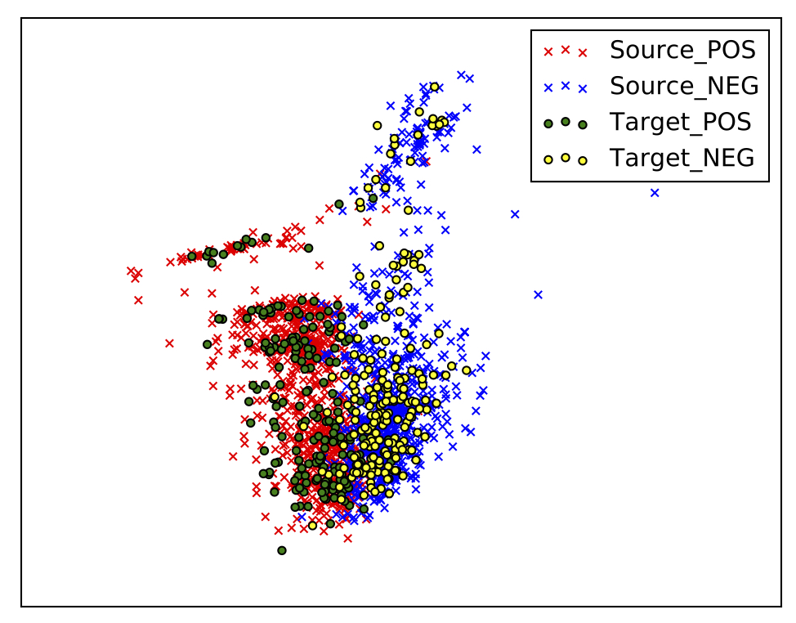
Visualization of Representation
Figure 9: Visualization by applying principal component analysis to the representation
of source training data and target testing data produced by AMN for E->K tasks.
Notes:
We have also visualized the representation of source training data and target testing data produced by our model, we can see they behave very similarly due to assigning high attention weights to the pivots, which contributes more to the domain-shared representations.

Slide 27
Future work
sent | Books (source domain) | Restaurant (target domain) | sent
 | Great books. His characters are engaging. | The food is great, and the drinks are tasty and delicious.
 | It is a very nice and sobering novel. | The food is very nice and tasty, and we’ll go back again.
 | A awful book and it is a little boring. | Shame on this place for the rude staff and awful food.
In the future, we will exploit the correlations between source non-pivots engaging, sobering and target non-pivots delicious, tasty with the captured pivots as a bridge.

Slide 28
Thank you!

